Slide 1
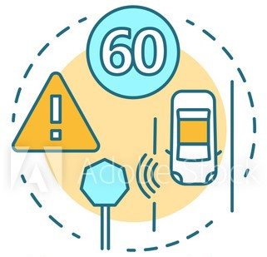
BE PROJECT
Group Members:
B150058523- Srishti Bankar
B150058619- Prajakta Lanje
B150058645- Siddhant Nikumbh
B150058649- Pallavi Dadape
Group ID: 32 Domain: ML/AI and IoT
Internal Guide:
Dr. K. A. Sultanpure
Date: 14-06-2021

Slide 2
INDEX
Problem Statement
Literature Survey
Based On Detection
Based On Recognition
Based On Dataset
Current Proposed systems
Proposed System
Scope
Technological Stack
System Architecture
Module Split Up
Dataset
Model Selection
Demo
References

Slide 3
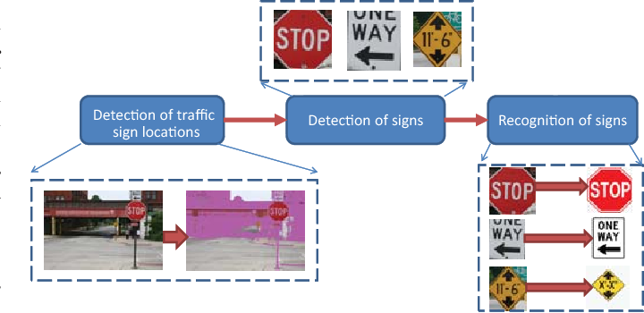
DRIVER ASSISTANCE SYSTEM
A near real time, lightweight and robust automatic traffic sign recognition which will support and disburden the driver, and thus, significantly increase driving safety and comfort.
Notes:
pd

Slide 4
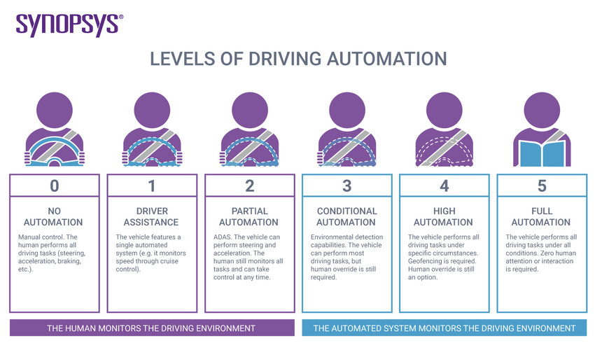

Slide 5
LITERATURE SURVEY
On-road applications of vision have included lane detection, driver distraction detection, and occupant pose inference. It is crucial to not only consider the car’s surrounding and external environment when designing an assist system but also consider the internal environment and take the driver into account. Fusing other types of information with the sign detector can make the overall system even better.
Current state-of-the-art TSR systems utilize neither information about the driver nor input from the driver to enhance performance. Extensive studies in human–machine interactivity are necessary to present the TSR information in a careful way to inform the driver without causing distraction or confusion. When the system is considered a distributed system where the driver is an integral part, it allows for the driver to contribute what he is good at.

Slide 6
Based on Sign Detection
The approaches in this stage have traditionally been divided
into two kinds:
Color-based methods
Shape-based methods
The division of systems in this way can be problematic. Almost all color-based approaches take shape into account after having looked at colors. Others use shape detection as their main method but integrate some color aspects as well. Instead, the detection can be split into two steps, i.e., segmentation and detection.

Slide 7
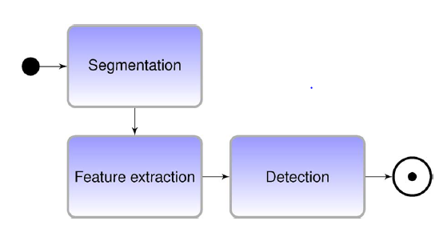
We go one step further and split the detection step into a feature extraction step and the actual detection, which acts on the features that are extracted. Many shape-only-based methods have no segmentation
step. The flow is outlined in the above figure.
Segmentation
Features and Modeling

Slide 8
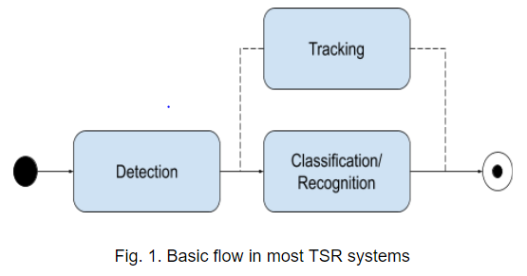
Based on Sign Recognition
Generally, TSR is split into two stages: detection and classification or recognition in the figure. Detection is concerned with locating signs in input images, whereas classification or recognition is about determining what type of sign the system is looking at.
Many TSR systems are tailored to a specific sign type. Due to the vast differences in sign design from region to region and the differences in sign design based on their purpose, many systems narrow their scope down to a specific sign type in a specific country. There is a wide span in speeds of the systems. For use in driver assistance and autonomous vehicles, real-time performance is also necessary.

Slide 9
Based on Dataset
German traffic Sign Recognition Benchmark (GTSRB) & German traffic Sign Detection Benchmark (GTSDB)
DFG Traffic sign Dataset
LISAD
RTSD

Slide 10
Until this date, we have 4 systems claiming 100% detection rate:
Traffic sign shape classification and localization based on the normalized FFT of the signature of blobs and 2D homographies
A Fast and Robust Traffic Sign Recognition
Fast shape-based road sign detection for a driver assistance system
Towards reliable traffic sign recognition
Generally, systems achieve detection rates well into the 90% range. A system that can detect several different sign types at low detection rate may, in some applications, be considered better than a system that can only detect one specific sign type but does that very well.

Slide 11
Incompetence of existing system and identified problems:
Low detection accuracy
High demand for hardware computational performance
Variations in the intensity of light, contrast
Angle of rotation in images of the localised traffic signs
No dataset based on Indian Traffic sign Convention.

Slide 12
SYSTEM OVERVIEW & SCOPE
A functioning system will be implemented using a standard web-camera mounted in a testing vehicle.
The most promising technology for intelligent vehicle systems is vision sensors and image processing. Our algorithm will take an image as an input(through camera) and first detect all the road signs. This information will be given to the recognizer to recognize all the detected road signs. Then the architecture will decide a speed limit for the observed signs and alert the driver accordingly.
The human-computer interface will be a simple screen where the detections and recognitions can be observed and alert will be displayed when the vehicle is in an unsafe state. Also a voice saying the alert can be developed.
This system is restricted to only traffic signs.
Notes:
pd

Slide 13
FUTURE SCOPE
For the future scope of this project, we shall first implement HD Maps to get the accurate data of the road which will also include the other vehicles and their position on the road.
With further improvisions, this system could also be used to recognize the lane markings and the traffic lights to warn the driver.
Another feature we shall add to this system will be a mobile application. All the data and notifications will be directed to the application installed in the driver’s mobile.
We also aim to make this system universal i.e. this system should be able to recognize the signs in any given language. Once this is achieved, this system will be capable of being used in any country across the globe to identify the signs.

Slide 14
SOFTWARE TOOLS
TECHNOLOGICAL STACK
OS - Linux based
Python
Pycharm
OpenCv, Tensorflow, Keras, Pytorch
For detection:- ResNet 50 under Faster RCNN
For recognition:- Wide ResNet 50 - 2

Slide 15


FLOWCHART OF PROPOSED SYSTEM
Calculate Minimum safe speed
Image Preprocessing
Traffic Sign detector
Traffic Sign recognizer
Current speed > Safe speed?
If yes
Image Post Processing threads
Alert
Notes:
pd

Slide 16
MODULE SPLIT UP
MODULE | PHASES
Detection | Dataset Selection and data loader creation. Model Benchmarking and selection. Training and testing and benchmarking on different datasets. API Creation and Optimization
Recognition | Dataset Selection and data loader creation. Model Benchmarking and selection. Training and testing and benchmarking on different datasets. API Creation and Optimization
Integration | GUI building Simple Integration of Models Optimizing the Program
Notes:
sb

Slide 17
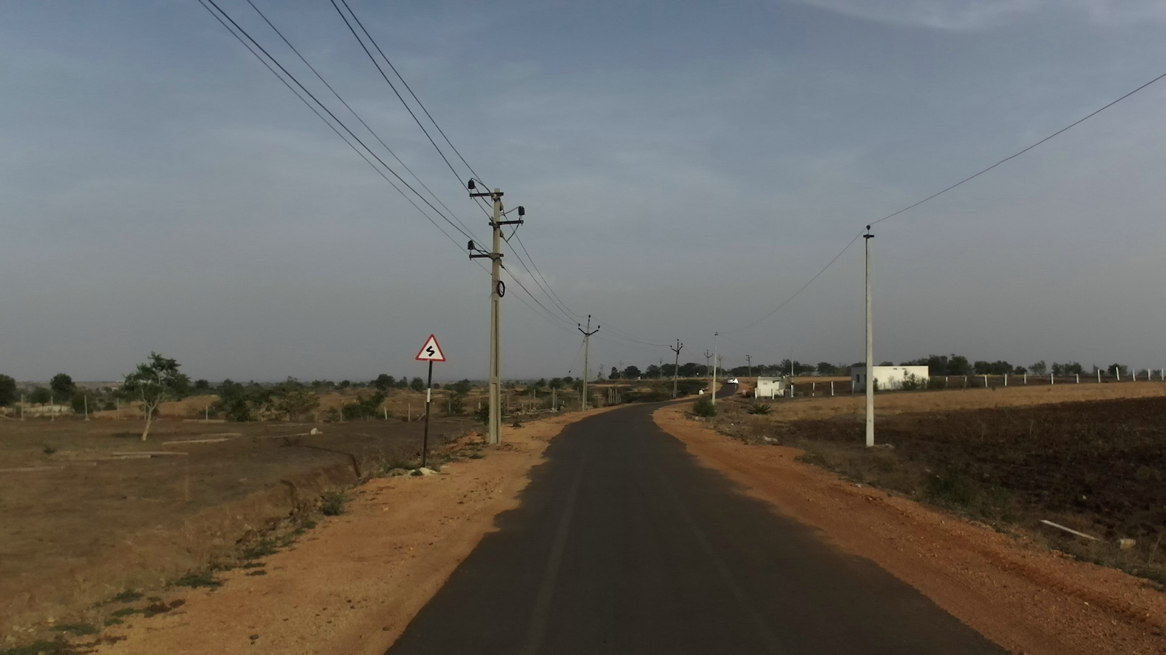
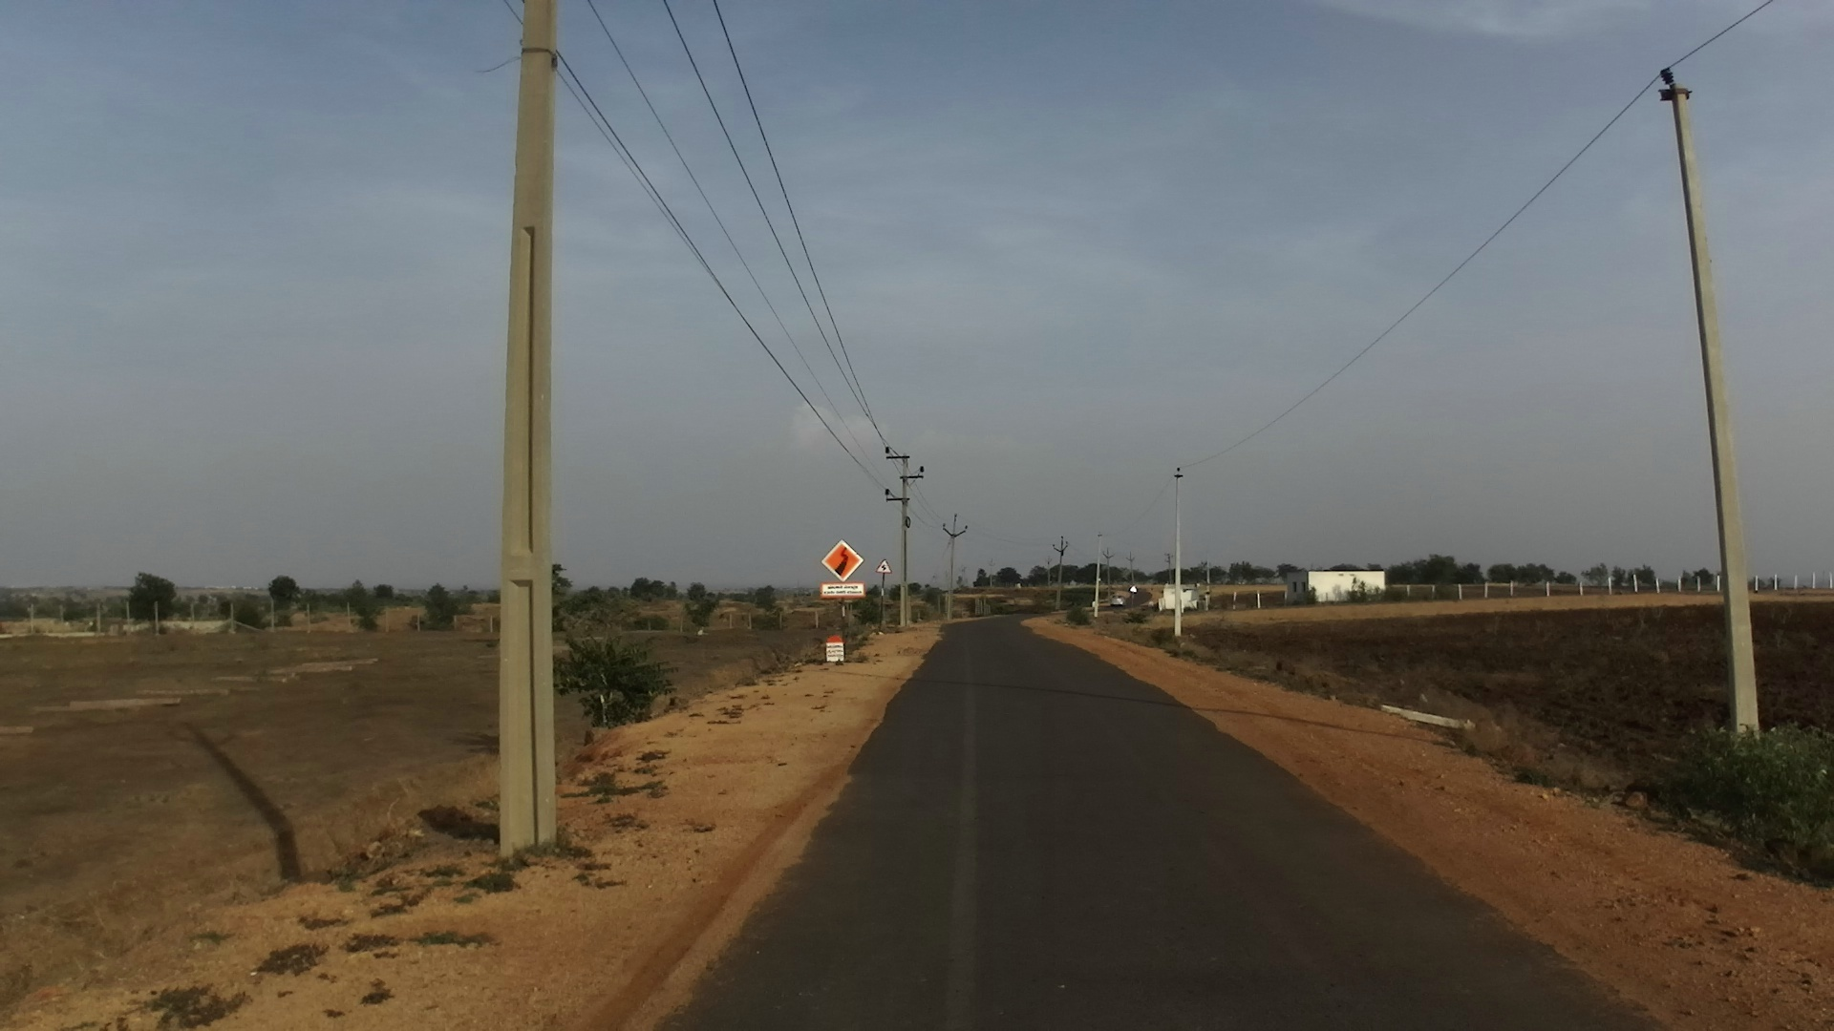
DATASET
The dataset consists of images obtained from a front facing camera attached to a vehicle.
The images are from Hyderabad, Bangalore cities and their outskirts.
The images are mostly of 1080p resolution, but there is also some images with 720p and other resolutions
Approximately 10,000 images are obtained after segregation.
Annotation of data.
Notes:
pr

Slide 18
Traffic Sign Recognition Model Benchmarking
Model Name | Top-1 Error | Top-5 Error | No. of Parameters | Inference Time (ms) | Validation Accuracy (%)
Wide ResNet-50-2 | 0.0105 | 0.0011 | 68.9 M | 64 ms | 100
Wide ResNet-101-2 | 0.0052 | 0.0007 | 126.9 M | 187 ms | 100
ResNet-152 | 0.0064 | 0.0009 | 80.3 M | 103 ms | 100
ResNet-50 | 0.0217 | 0.0098 | 23 M | 23 ms | 99.67
Notes:
sn

Slide 19
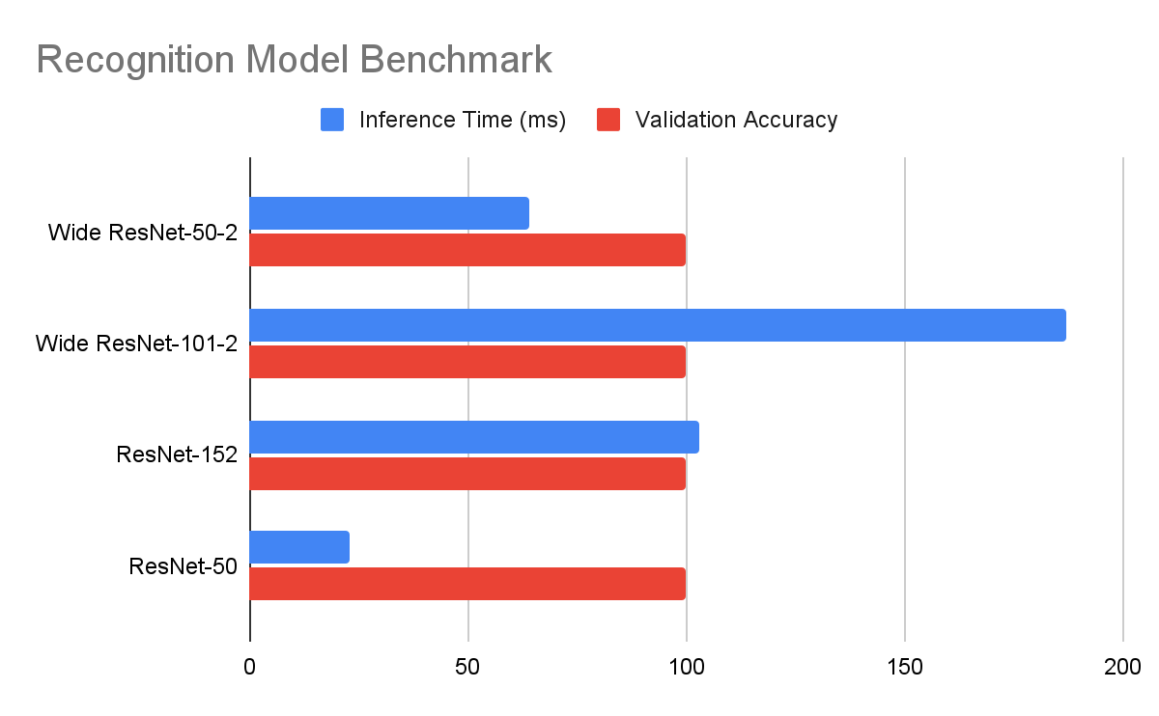
Notes:
sn

Slide 20
Traffic Sign Detection Model Benchmark
Backbone | Style | LR Scheduler | Memory (GB) | Inference Time | Box mAP
Faster RCNN R-50-FPN | PyTorch | 3x | 4 | ~8fps | 88.81
Faster RCNN R-50-FPN | Caffe2 | 2x | 4 | ~6fps | 81.24
Faster RCNN R-50 | Tensorflow | - | 5.3 | ~8fps | 86.52
Faster RCNN R-101 | Tensorflow | - | 7.2Gb | ~4fps | 91.52
R-FCN R-101 | Tensorflow | - | 4.5Gb | ~5fps | 87.16
Yolo v3 | PyTorch | 1x | 2.3Gb | ~24fps | 66.10
Notes:
sn

Slide 21
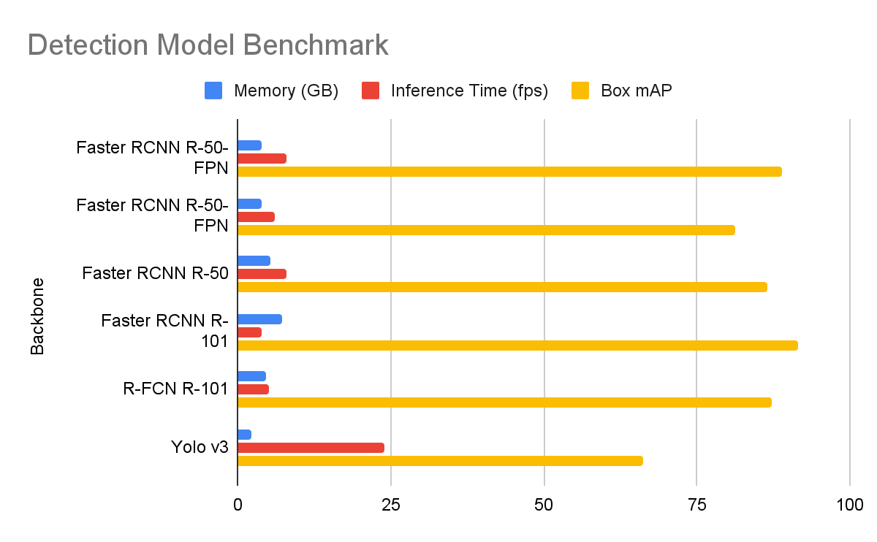
Notes:
sn

Slide 22
DEMO

Slide 23
REFERENCES
An Approach towards Service System Building for Road Traffic Signs Detection and Recognition - Natalia Kryvinska, Aneta Poniszewska-Maranda, Michal Gregus
https://reader.elsevier.com/reader/sd/pii/S1877050918318003?token=6BF470414EE0E2C054C3B861CFBF4D1B63DAE404850F13A07BECDC453552AC1A2236C00356B42C2ACE995F376EED160A
Vision-Based Traffic Sign Detection and Analysis for Intelligent Driver Assistance Systems: Perspectives and Survey
Traffic sign shape classification and localization based on the normalized FFT of the signature of blobs and 2D homographies | Signal Processing
(PDF) A Fast and Robust Traffic Sign Recognition
Fast shape-based road sign detection for a driver assistance system
https://ieeexplore.ieee.org/abstract/document/5164298

